Slide 1

CE101 Engineering Drawing Lec7: Section of Solids
Indian Institute of Technology Guwahati
Notes:
Today we will discuss about the Modeling and

Slide 2
FEW TYPICAL EXAMPLES Part I
(QUESTION NOT PROVIDED)

Slide 3
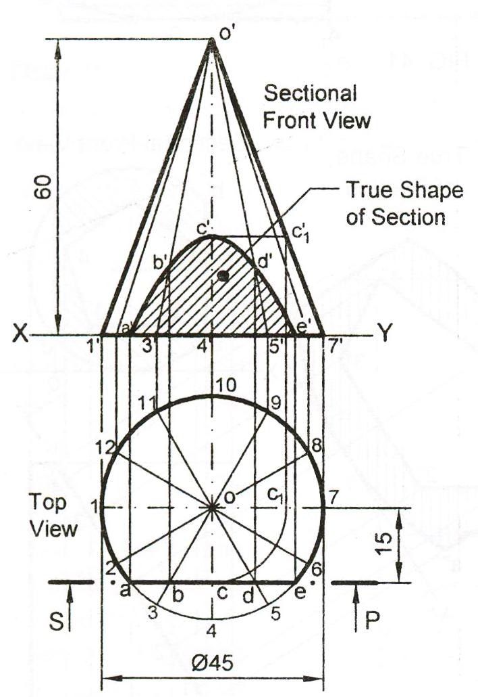
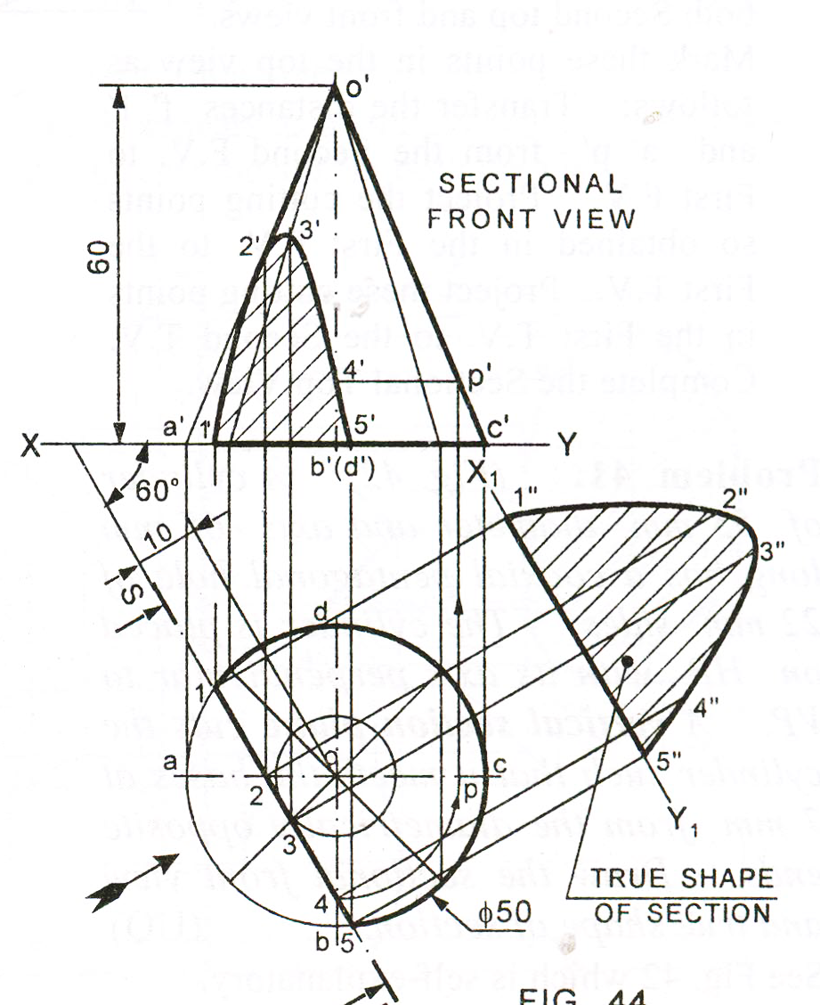

Slide 4
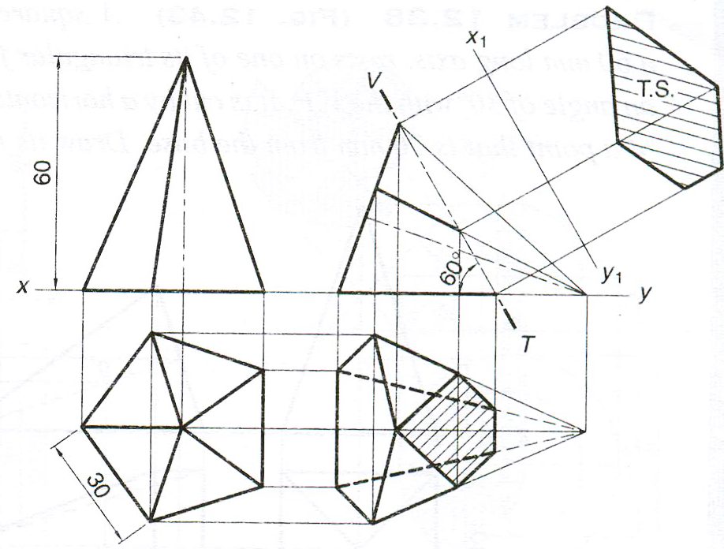
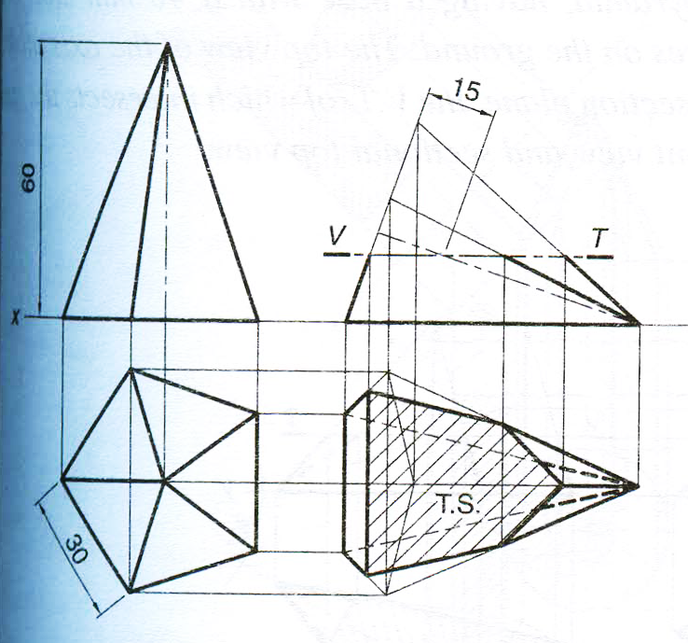

Slide 5
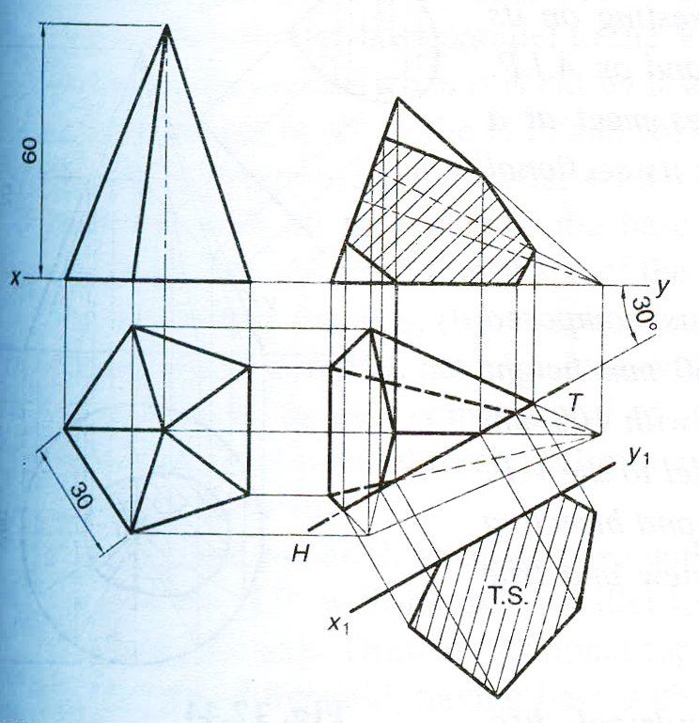
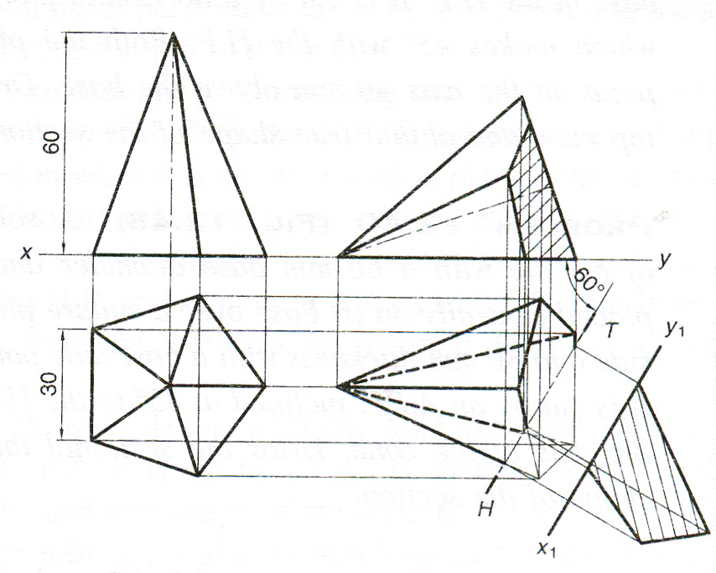

Slide 6
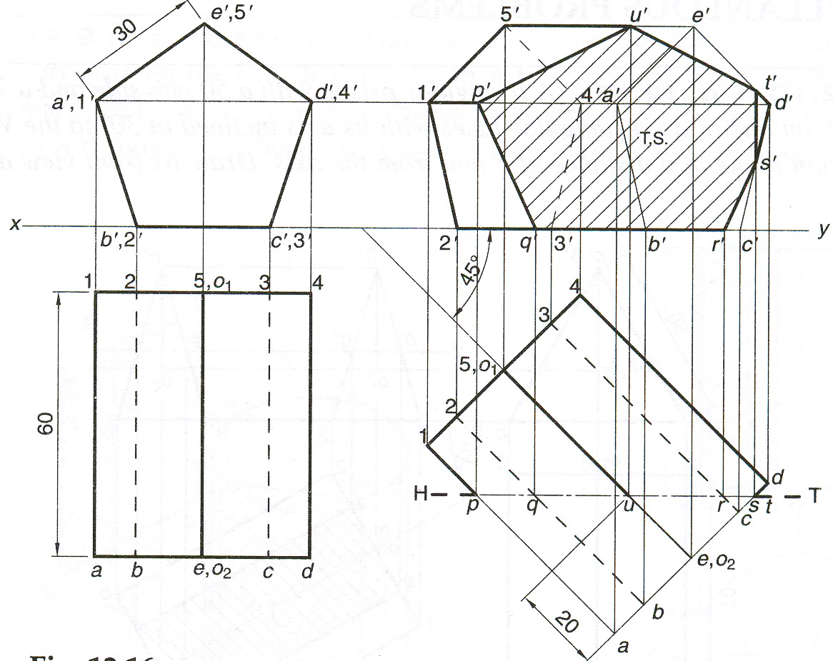

Slide 7
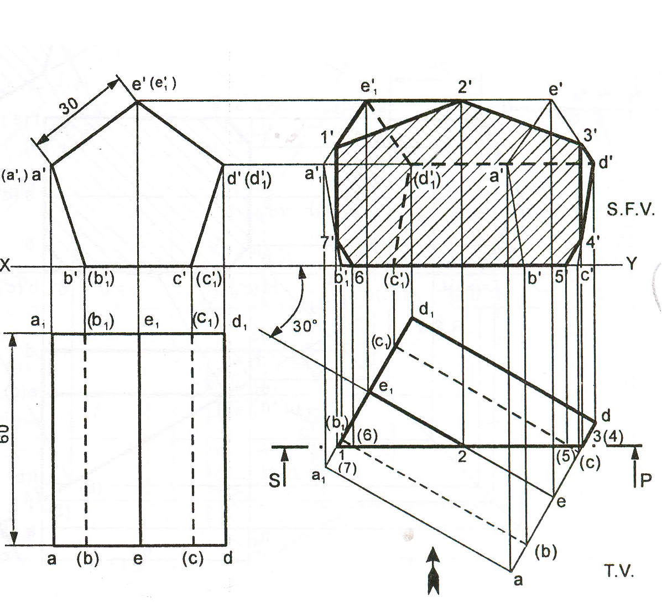

Slide 8
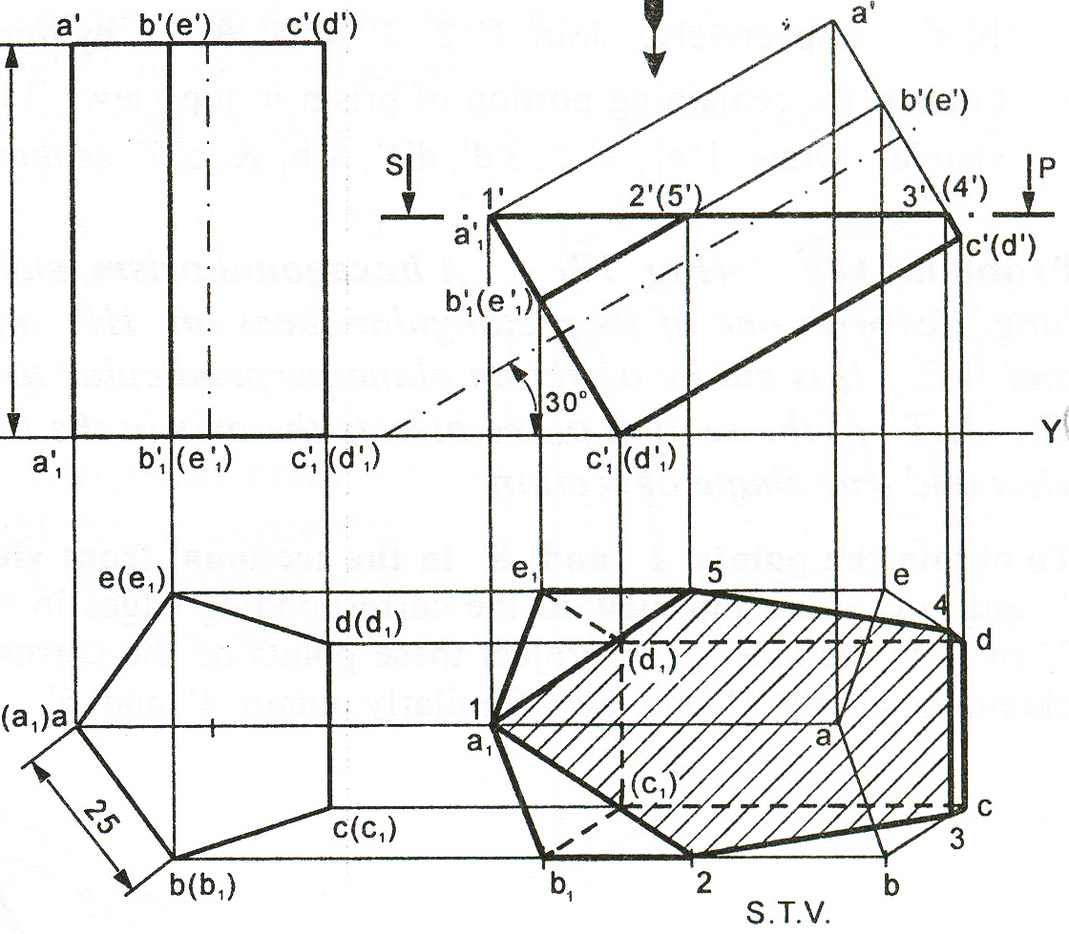

Slide 9
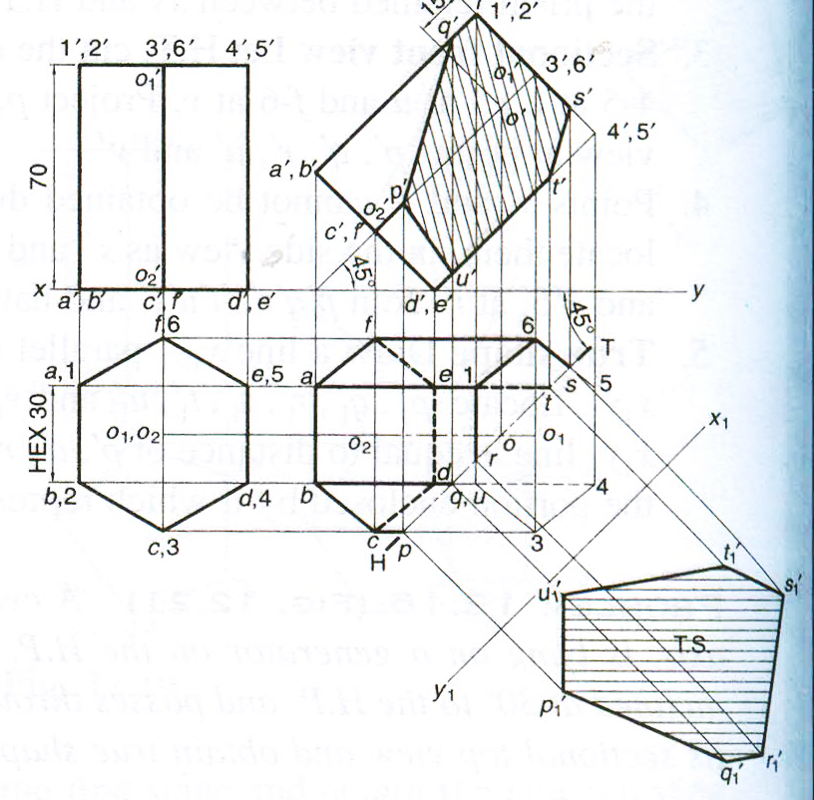

Slide 10
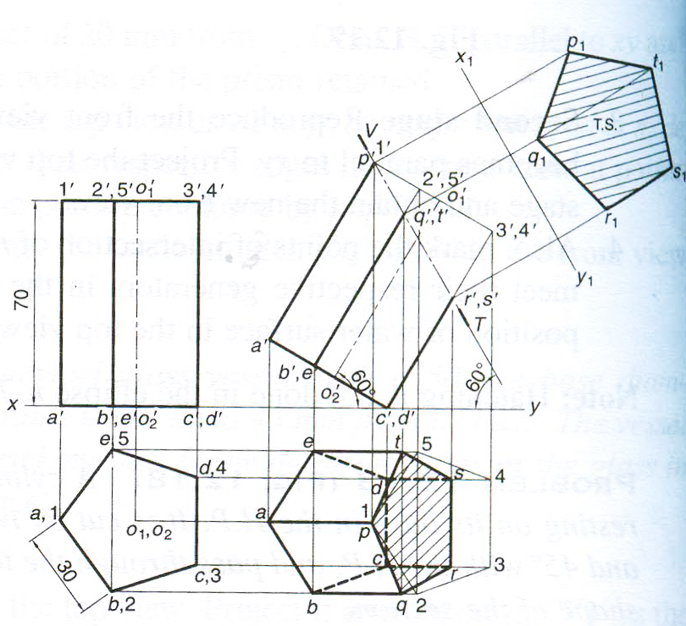

Slide 11

Thank You for Patient Hearing

